Slide 1
Century Mold and Tool Company & Centech Plastics Inc.
Manufacturing Capabilities

Slide 2
Purpose of today’s presentation
To present Century Mold & Tool Company’s design & mold construction capabilities.
To present Centech Plastics injection molding, decorating, and assembly services.
To be a partner in solving your tooling, and manufacturing problems on new plastic injection molded products.
To provide a “one stop” service Team.

Slide 3
Underwriters Laboratories Inc.
Centech Plastics Inc.
UL File No. QMMY2.E200558
Fabricated plastic parts, Recognition based on material traceability.
UL assigned designation B-1694

Slide 4
Industries Served:
Automotive (Functional & Decorative)
Telecommunications
Consumer Electronics
Appliance Controls (Consumer Durable)
Industrial Electronics
Consumer Packaging

Slide 5
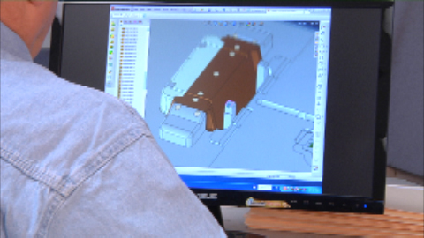
Century Mold & Tool Co. Mold Design Capabilities
Mold design utilizing:
Qty 2 - In-house designers
Qty 6 - Outside contract designers.
Qty 3 - Pro/Engineer v2001, 3-D Parametric Solid Modeling CAD Design System with Pro/Mold Tooling Design Package
Qty 3 - Cadkey Workshop v20, 3-D CAD System
Qty 1 - Cimatron 3-D Solid Modeling CAD System

Slide 6
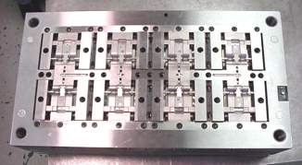
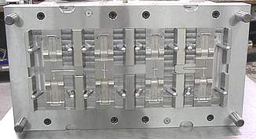
Century Mold & Tool Co. Mold Building Capabilities:
Complete Mold build and repair:
Our mold makers utilize the latest and most efficient equipment technology in mold construction.
Average tool completion for a 2-cavity part is approximately 6-8 weeks.

Slide 7
Surface Grinding

Slide 8
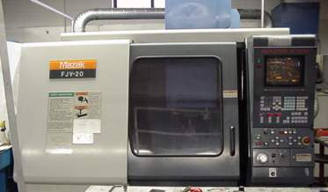
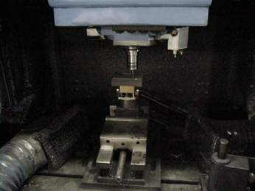
High Speed CNC Vertical Mills for Machining EDM Carbon Electrodes

Slide 9
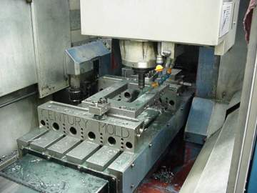
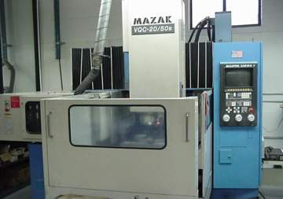
3-Axis, CNC Vertical Milling Machines with Auto-Tool Changer

Slide 10
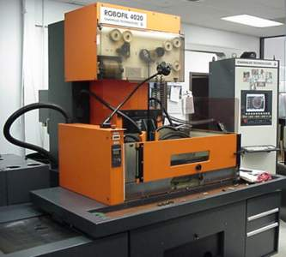
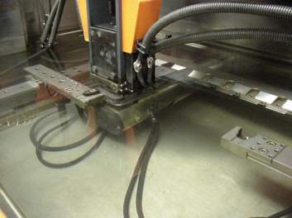
Charmilles 4-Axis,CNC Wire EDM with Auto-Threading

Slide 11
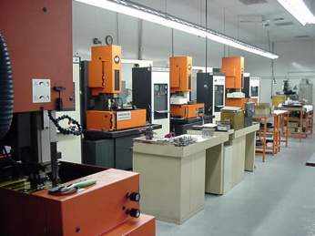
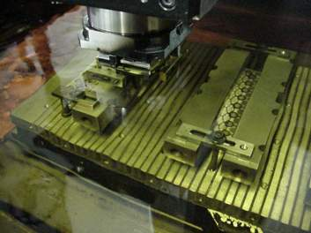
Charmilles CNC Die Sinking EDM with Auto-Tool Changers

Slide 12
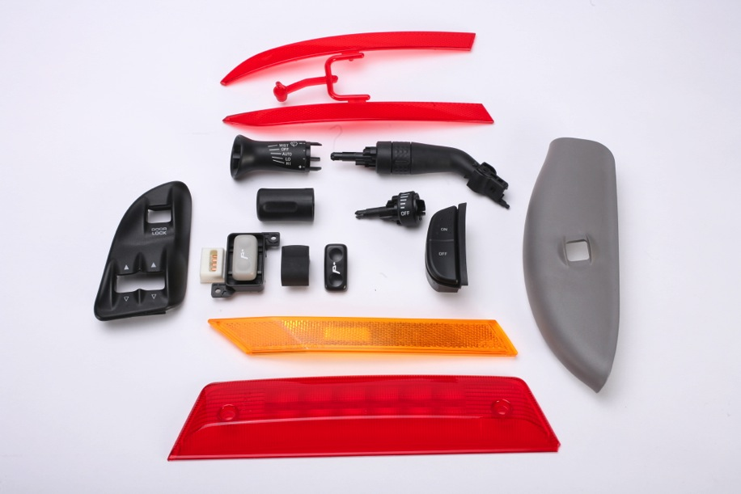
Products produced from molds designed & built by Century Mold & Tool Co.

Slide 13
Centech Plastics Inc. Injection Molding Capabilities
Conventional “Tight Tolerance” thermoplastic injection molding ranging from 30 to 330 ton presses.
“Thin Wall” injection molding with wall stock down to .381mm (0.015 inches).
Thermoplastic “Insert Molding” with metal stampings.
“Reel-to-Reel” insert molding with metal stampings.
“In-Mold Decorating” utilizing formed appliqués.
“Over-Molding” of backlit knobs and buttons.
“Double Shot” of Two-color/Dissimilar Material/Mixed-color molding.
“Ultrasonic Welding” of Plastics for assembly.
“Heat Staking” for assembly or insertion of threaded bushings.
Decorative “Pad Transfer” and “Hot Stamp” printing of multi-color images on plastic surfaces.
“Assembly” and “Packaging” services.

Slide 14
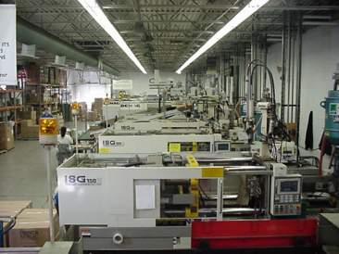
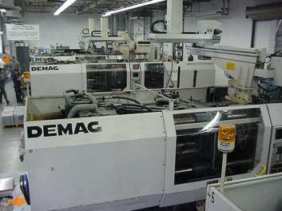
“Tight Tolerance” Horizontal Injection Molding 30 to 330 Tons

Slide 15
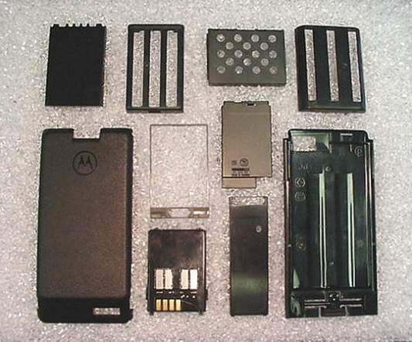
“Thin Wall” Molded Product at 0.015 Inches (0.38mm)

Slide 16
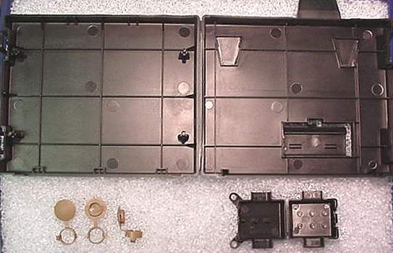
Molded Product With “Living Hinge”

Slide 17
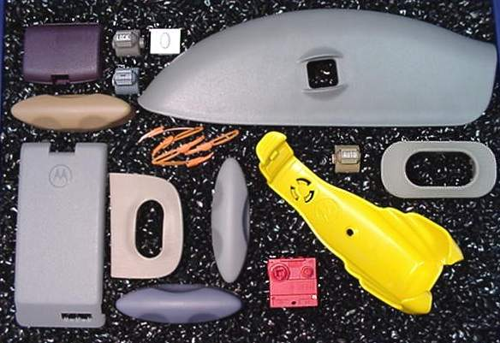
“Decorative” Molded Product

Slide 18
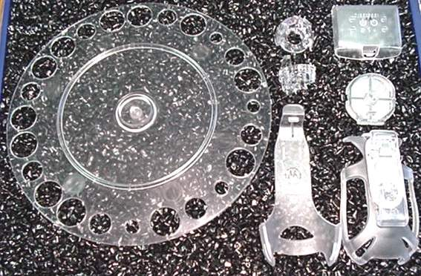
“Transparent” Molded Product

Slide 19
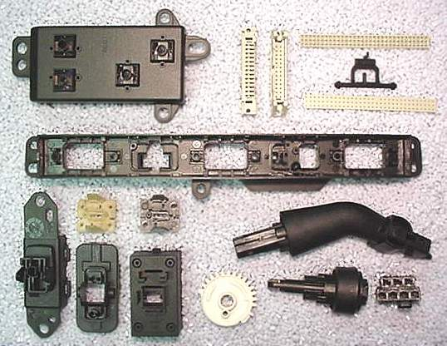
“Functional” Molded Product

Slide 20
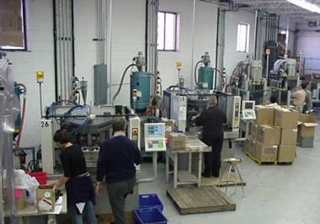
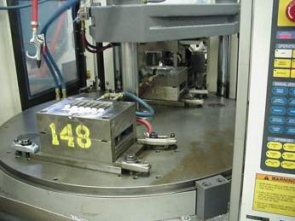
“Vertical Clamp” Insert Molding

Slide 21
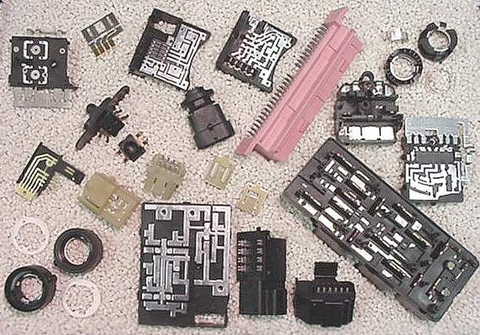
“Functional” Insert Molded Product

Slide 22
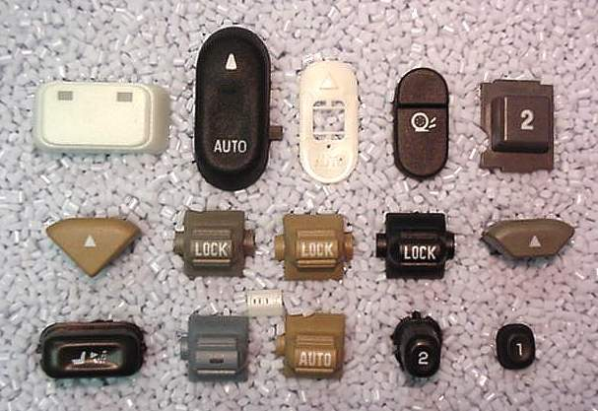
“Decorative/Backlit” Over-Molded Product

Slide 23
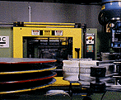
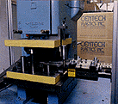
“Reel-to-Reel” Insert Molding

Slide 24
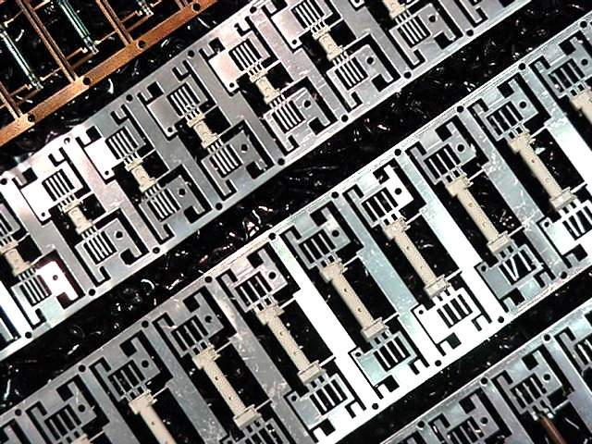
“Reel-to-Reel” Insert Molded Product

Slide 25
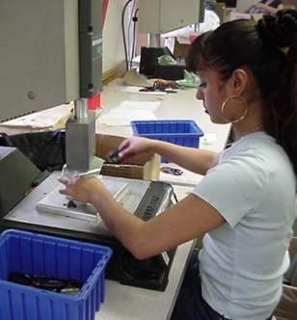
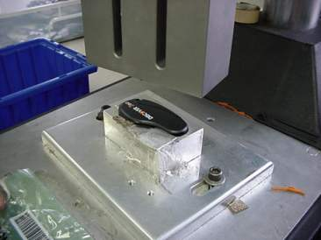
Secondary Operations: “Ultrasonic Welding” of Plastics

Slide 26
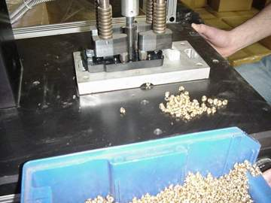
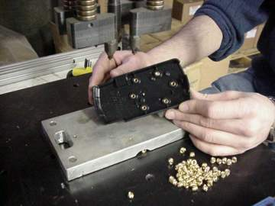
Secondary Operations Con’t: “Heat Staking” of Brass Inserts into Plastic Housings

Slide 27
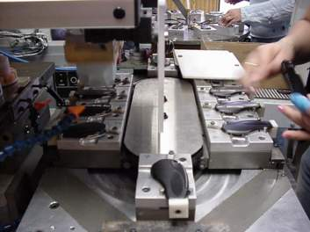
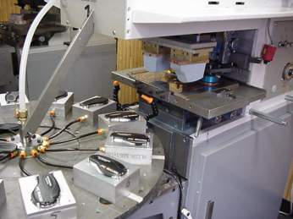
Secondary Operations Con’t: “Pad Transfer” Printing (1-4 Colors)

Slide 28
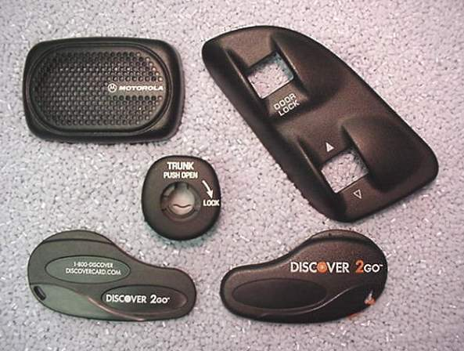
“Pad Transfer” Printed Product

Slide 29
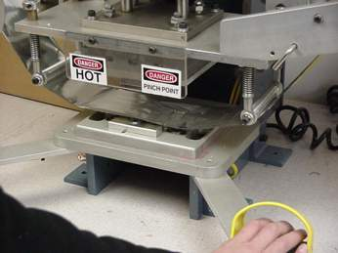
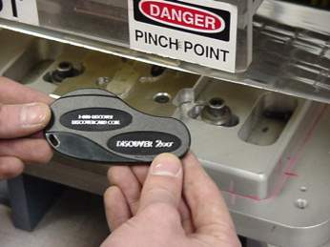
Secondary Operations Con’t: “Hot Stamp” Printing on Plastics

Slide 30
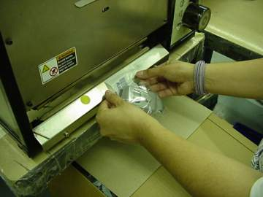
Secondary Operations Con’t: Poly-Bag Heat Sealing & Packaging

Slide 31
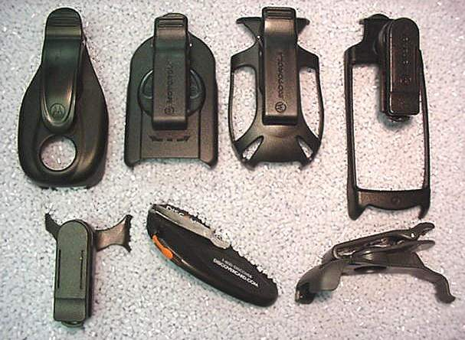
Assembly Services

Slide 32
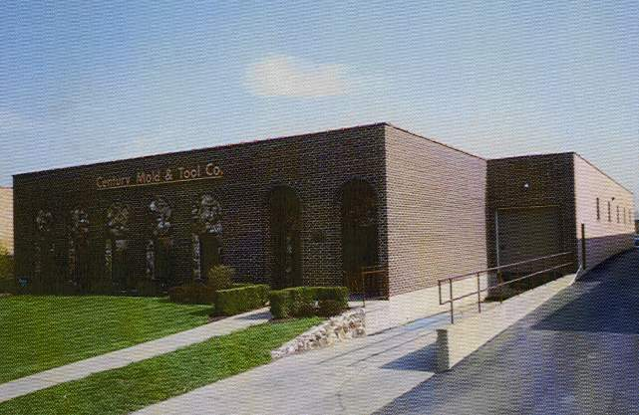
Facility Information
12,500 Sq. Ft. of Engineering and Mold Construction services.
15,000 Sq. Ft. dedicated to Plastic Injection Molding services.
12,500 Sq. Ft. of Decorative Pad Transfer & Hot Stamp Printing and Warehouse space
Grand Total of 40,000 Sq. Ft.

Slide 33
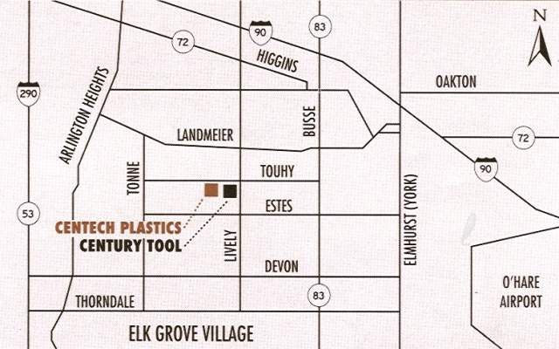
Directions to our facility

Slide 34
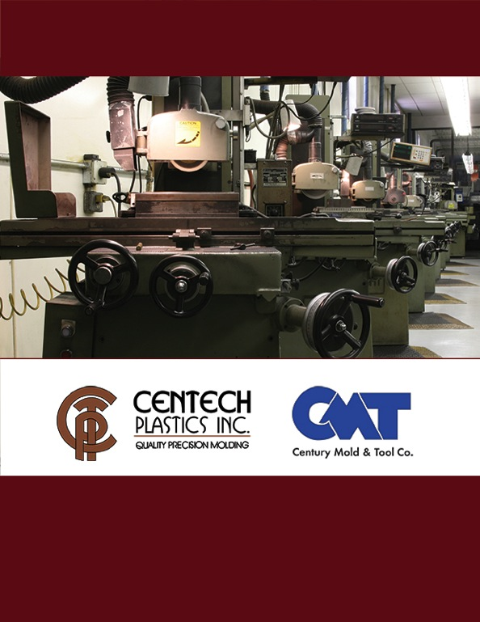
For More Information Contact:
Century Mold & Tool Company
Centech Plastics, Inc.
835 Touhy Avenue
Elk Grove Village, IL 60007-4917
Phone: 847-364-4433
Fax: 847-364-1144
Web site:
www.centurycentech.com

